Slide 1

ReSharper Course
Making Waves @ Oslo
Part 2

Slide 2
Navigation
Navigational axis
Type name
Method
Proximity
We remember strange things

Slide 3
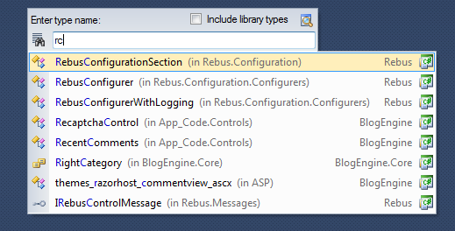
Go to ...
Go to
Type
File
Symbol
Member

Slide 4
CamelHumps
Powerful search filters
Ubiquitous in ReSharper
Splits names into searchable parts
ReaderWriterLock
Reader
Writer
Lock

Slide 5
CamelHumps
rwl → ReaderWriterLock
readw → ReaderWriterLock
rwrit → ReaderWriterLock
writ → ReaderWriterLock
rs → ReaderWriterLock

Slide 6
CamelHumps
Extensions treated as seperate part
rwlcs → ReaderWriterLock.cs
Space filters containing entities
t r → System.Threading.ReaderWriterLock
t r → \Threading\ReaderWriterLock.cs
r rl → ReaderWriterLock.ReleaseLock()

Slide 7
Exercise: Go to...
Find shortest key sequence
Go to type
Ctrl + T
Go to file
Ctrl + Shift + T
Go to symbol
Alt + Shift + T
Go to member
Alt + <

Slide 8
Code Interaction
Based on
Selection
Caret placement
Contextual actions
Quick fixes
Navigation
Refactoring
Inspection

Slide 9







Code Analysis
Contextual help
Hints
Suggestions
Dead code
Warnings
Errors
Side bar

Slide 10
Exercise: Code Analysis
CodeAnalysis.sln
Quick fix
Alt + Enter
Go to next / previous error
Alt + Shift + PageDown / PageUp
Go to next / previous suggestion
Alt + PageDown / PageUp

Slide 11
Reduce Mechanical Steps
Raise abstraction for actions
Working with code instead of text
Type: public SomeClass(string text) { }
Type: private string text;
Type: this.text = text;
VS
Action: Generate constructor
Type: string text
Action: Assign constructor parameter to field

Slide 12
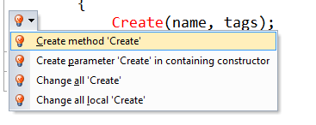
Generate Code
Quick Fix
Scaffolding new code
Methods
Variables
Classes

Slide 13
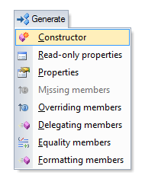
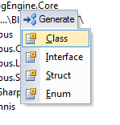
Generate Code
Generate code
Interacts with fields
Generate code
Solution Explorer

Slide 14
Exercise: Generate Code
Quick fix
Alt + Enter
Generate code
Alt + Insert

Slide 15
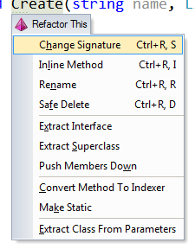
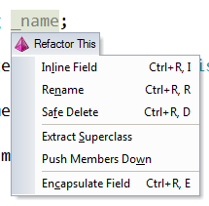
Code Refactoring
Contextual refactoring
Refactor this
Based on selection or caret

Slide 16


Refactor: Rename
Most basic refactoring
Renames almost anything

Slide 17
Exercise: Refactor - Rename
Cleaning up bad variable names
Refactor this
Ctrl + Shift + R
Refactor: Rename
Ctrl + R, Ctrl + R

Slide 18
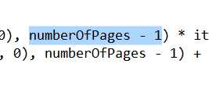


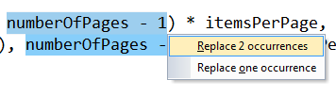
Refactor: Introduce variable
Extract an expression into a variable

Slide 19

Refactor: Inline variable
Opposite of Introduce variable
Replaces variable with expression

Slide 20
Exercise: Introduce and Inline variable
Refactor this
Ctrl + Shift + R
Refactor: Introduce variable
Ctrl + R, Ctrl + V
Refactor: Inline variable (or method)
Ctrl + R, Ctrl + I

Slide 21
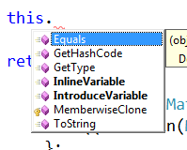
Completion Modes
Intellisense
Import Completion
Smart Completion

Slide 22


Import Completion
Completes types from available assemblies
Inserts relevant imports on completion

Slide 23

Import Completion
Also works for extension methods

Slide 24


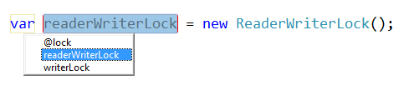
Completion + Introduce Variable
Saving keystrokes with name suggestions

Slide 25
Exercise: Import Completion
Import Completion
Alt + Shift + Space
Refactor: Introduce variable
Ctrl + R, Ctrl + V

Slide 26
Usage Inspection
Highlight symbol
Single method or small class
Find usages
Single public method or property
Method tracking
Entire flows

Slide 27
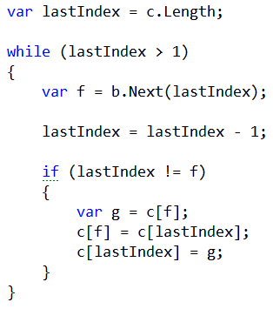
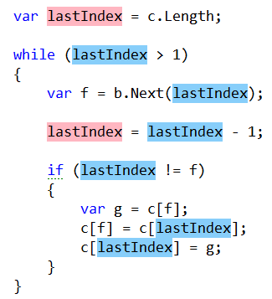

Highlight Symbol
Highlights reads and writes of a symbol

Slide 28
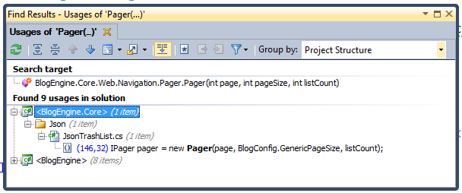
Find Usages
Lists usages of the given symbol
Allows for easy navigation

Slide 29
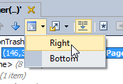
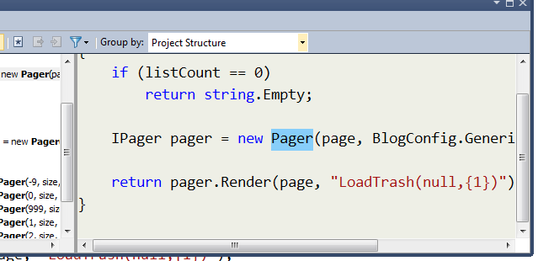
Find Usages
Useful to set up previews

Slide 30
Exercise: Find Usages and Highlight
Find usages
Shift + F12
Highlight symbol
Alt + Shift + F11
Remove highlight
Esc
Go to next usage
Alt + Ctrl + PageDown
Go to previous usage
Alt + Ctrl + PageUp

Slide 31
Solution Explorer Refactorings
Usually a pain to change project structure
Refactorings
Move types into matching files
Adjust namespaces
Move files into folder

Slide 32
Moving Files
Cut / Paste + Adjust namespaces
More natural
Move files into folder
Useful for cross-project moves

Slide 33
Exercise: Solution Explorer Refactorings
Refactor this
Ctrl + Shift + R
Focus Solution Explorer
Alt + Ctrl + L

Slide 34


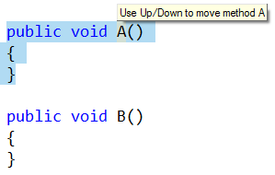
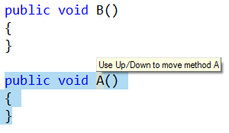
Move Code
Caret based code moving

Slide 35
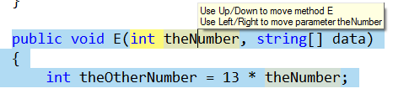

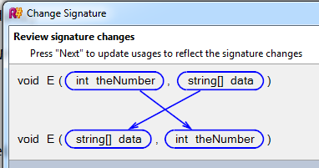
Move Code

Slide 36
Exercise: Move Code
Quick fix
Alt + Enter
Move code up
Alt + Ctrl + Shift + Up
Move code down
Alt + Ctrl + Shift + Down
Move code in / right
Alt + Ctrl + Shift + Right
Move code out / left
Alt + Ctrl + Shift + Left

Slide 37
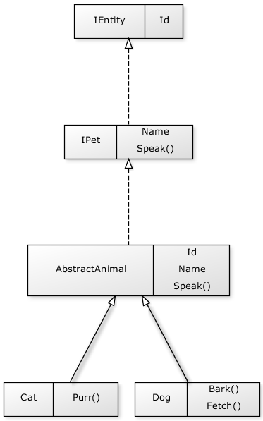
Navigating Hierarchies
Go to
Declaration
Implementation
Base
Derived
Type Hierarchy

Slide 38
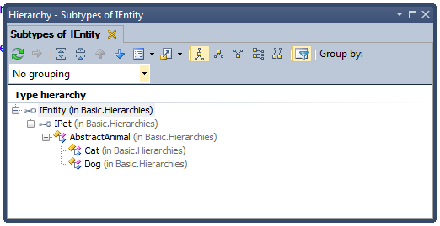
Type Hierarchy
Shows inheritance hierarchies

Slide 39
Exercise: Navigate hierarchies
IActivateHandlers
Type hierarchy
Ctrl + E, Ctrl + H
Go to declaration
F12
Go to implementation
Alt + Ctrl + Shift + B
Go to base
Alt + Home
Go to derived
Alt + End
IContainerAdapter
SimpleHandlerActivator
AbstractContainerAdapter
WindsorContainerAdapter
StructureMapContainerAdapter

Slide 40
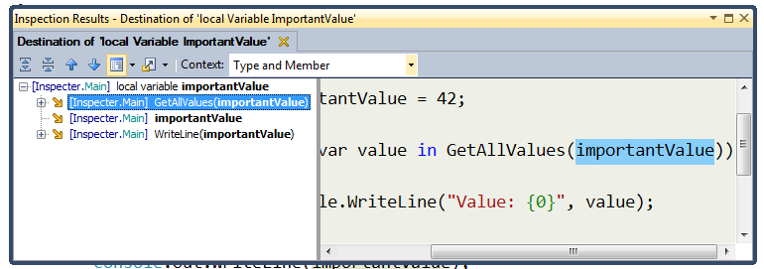
Inspect This
Powerful analysis
Values
Methods

Slide 41
Exercise: Inspect This
Inspect this
Alt + Ctrl + Shift + A

